Slide 1
Spy Plane Finder
DAEN 690 Project
Spring 2018

Slide 2
Spy Plane Finder
Team :
Shravan Chintha
Shreyasi Thota
Meghna Kathuri

Slide 3
DAEN 690
Project Sprints
Sprint
Milestone Goals
Presentation
Problem Definition and Project Plans
Problem (decision) defined
Understanding of complexity
Potential data source identified
Potential analytics identified
Project schedule defined
Participant roles assigned
Risks identified and mitigation plan
Feb 15
Data Sets
Data located and accessed
Initial processing underway
Risks identified and mitigated
Mar 8
Analytics/algorithms
Algorithms defined and coded
Initial applications completed
Risks identified and mitigated
Mar 22
Visualizations
Visualization concepts defined
Visualization implemented
Risks identified and mitigated
Apr 12
Final Presentations
Project components completed
Project components integrated
Project supports final decision
Presentation made
May 10
Project schedule defined

Slide 4
Spy Plane Finder Problem Definition and Planning
Mid-Sprint 1 Presentation
7 February 2018

Slide 5
Sprint Goals
Participant roles assigned
Project schedule defined
Problem (decision) defined
Understanding of complexity
Risks identified and mitigation plan

Slide 6
Spy Plane Finder
Team Roles:
Product Owner – Project Team
Scrum Master – Shravan Chintha
Developer – Shreyasi Thota
Developer – Meghna Kathuri
Tools
Team will use GitHub as our development resource.
Will use YouTrack for tracking all Sprints
Blackboard for Journal and File Sharing for collaboration
Kaggle
Business Rhythm:
Weekly Meetings and collaborations
Participant roles assigned

Slide 7
Sprint 1 Schedule
a) Initial set of stories (Backlog)
b) Each story the team will define a set of tasks to complete the story
c) Each story will have evaluation criteria for exiting the story (basically we have a high degree confidence that it is complete)
d) These stories will be entered into YouTrack Tool
e) At this point has created a set of stories for Sprint 1 (most likely this will be all the stories since they will be focused Problem Definition for the Project Team)
f) The Business Owner (DAEN 690 Instructors) will provide questions and feedback.
g) The Project Team should be creating Sprint 2 stories and entering them in the Project Backlog on YouTrack
Mid-Sprint - February 7, 2018. status and presentation is by the Product Owner. The Business Owner will provide questions and feedback.
Sprint 1 - Demo--February 14, 2018.
Product Owner - initial overview of the stories and each story will be briefed by a combination of Product Owner and Product Team Members
Business Owner - questions and feedback.
Sprint 1 schedule defined

Slide 8
Problem Definition
Initial Story :
As a user I want to analyze and train a machine learning algorithm that will detect aircrafts other than the spy planes operated by the FBI and the department of homeland security basing on their surveillance, characteristics and other features.
Lexicon:
Adshex: Unique identifier for each aircraft, corresponding to its "Mode-S" code, in hexademical format.
Squawk: Four-digit code transmitted by the transponder.
Timestamp: Full UTC timestamp duration of each flight segment recorded by Flightradar24, in minutes.
Boxes: Area of a rectangular bounding box drawn around each flight segment, in square kilometers.
Problem defined

Slide 9
Project Abstract
The project aspires to come up with a machine learning model specifically a classification model which can help identify and classify the flights encompassing the United States, Alaska, Hawaii, and Puerto Rico areas basing on various parameters by comparing them with the specifications of the spy planes belong to the FBI and Homeland security department.
This is done by firstly filtering the data obtained from Flightradar24 by removing the flights recorded in the area which are the following:
Commercial flights
Abroad flights basing on the adshex index
After which DURATION of each flight which is segment recorded by Flightradar24, in minutes and BOXES which refers to the Area of a rectangular bounding box drawn around each flight segment, in square kilometers are calculated basing on which further processing and classification is performed to yield our objective results.

Slide 10
Potential Data sources
The data is available in Kaggle datasets.
The data source utilized for this work is taken from a plane tracking website Flightradar24 which covers data from August 2015 to December 2015.
Flightradar24 receives data from its network of ground-based receivers, supplemented by a feed from ground radars provided by the Federal Aviation Administration (FAA) with a five-minute delay
Potential data sources identified

Slide 11
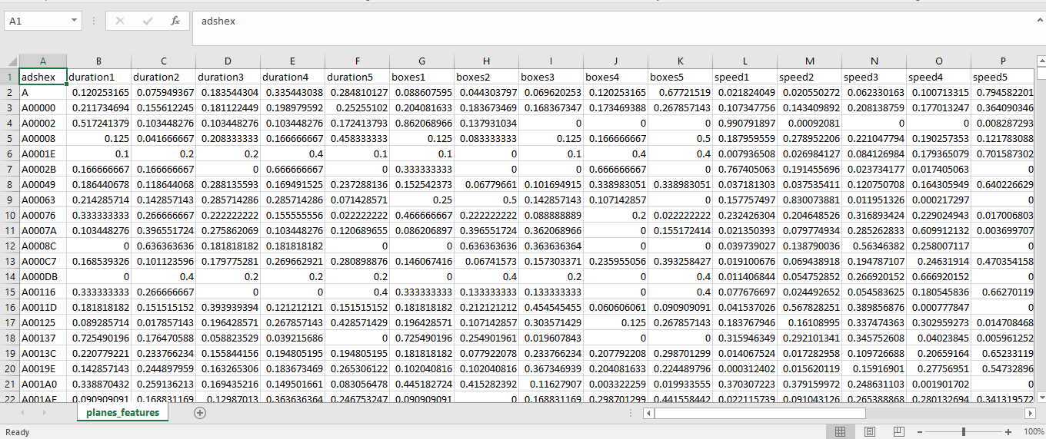
Dataset
Potential data sources identified

Slide 12
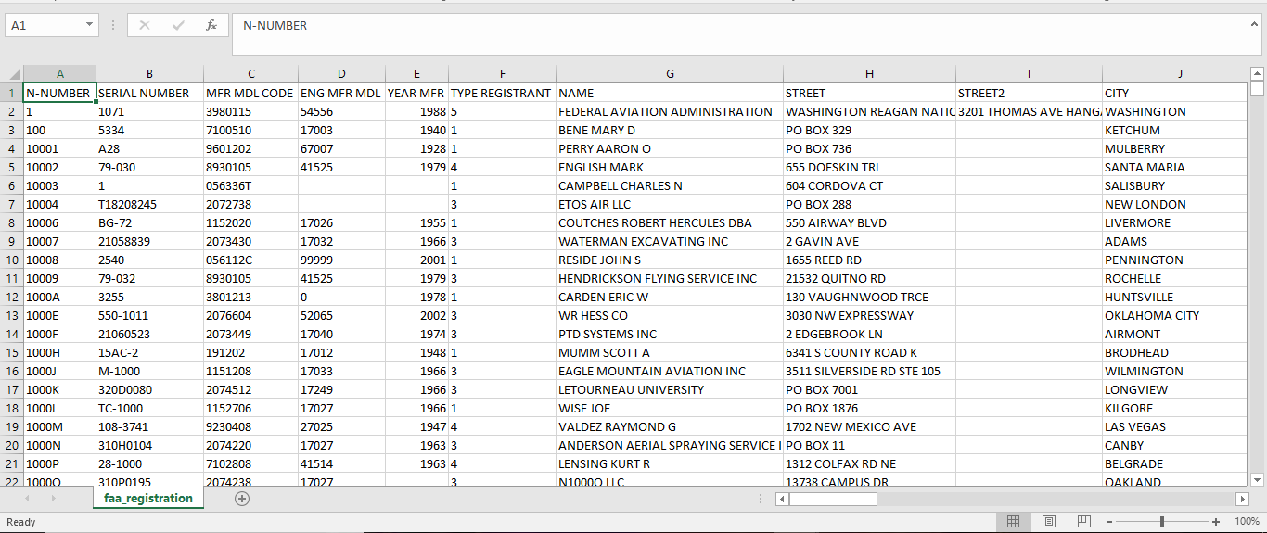
Dataset
Potential data sources identified

Slide 13
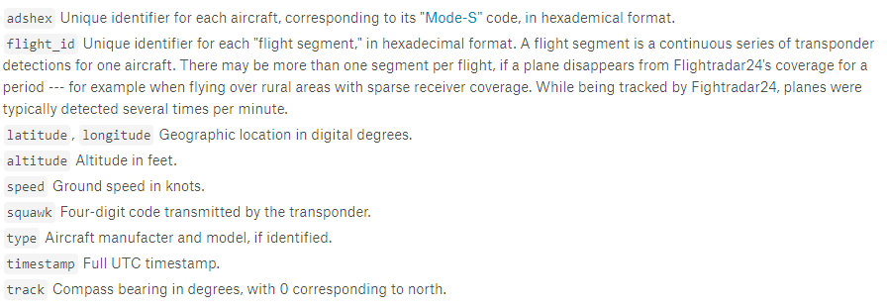
Data dictionary
Potential data sources identified

Slide 14
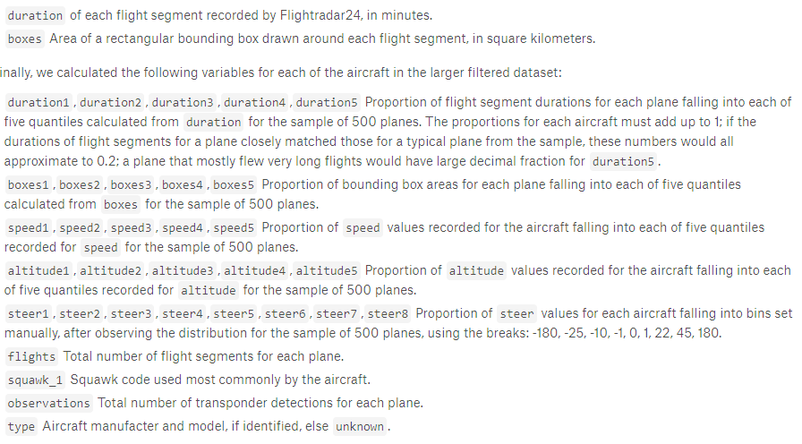
Data dictionary
Potential data sources identified

Slide 15
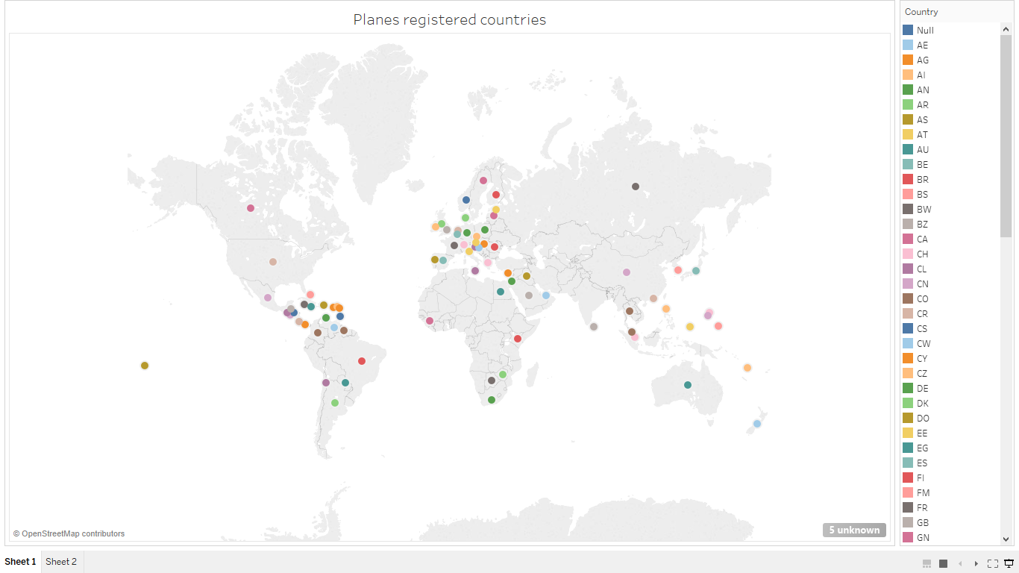

Slide 16
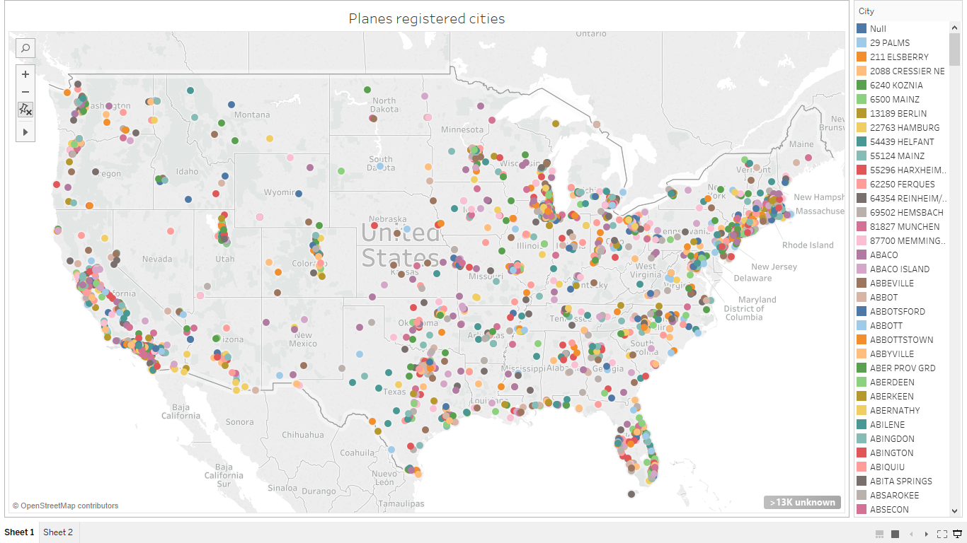

Slide 17
Potential Analytics
Data Preprocessing and manipulation techniques
Classification Algorithms
Other machine learning algorithms
Potential analytics identified
Notes:
Suggest we concentrate on Metadata and NLP and NOT Externals other than what results from associations between metadata and content

Slide 18
Complexity [Team’s assessment of Project Complexity]
DAEN 690
Understanding of Complexity

Slide 19
Risks and Planned Mitigations
Risk: Our data is too big for our processing capabilities
Probability: medium
Impact: medium
Mitigations:
Take subset of data
Consider AWS / Microsoft Azure / Other big data processing site
Hydra
Risk: Analytic methods fail
Probability: high for any one method-data combination
Impact: medium
Mitigations:
Prototype early
Apply multiple techniques
Integrate
Risks Identified and Mitigation Plan

Slide 20
Assumptions
The data is independent and identically distributed
Models are trained on a set and tested on the other with an assumption that the data is highly correlated.
When using a linear classifier the decision boundaries are linear and in other situations when using a neural network with one hidden layer has sufficient complexity to model the underlying function.

Slide 21
Backup
Enter at your own risk

Slide 22
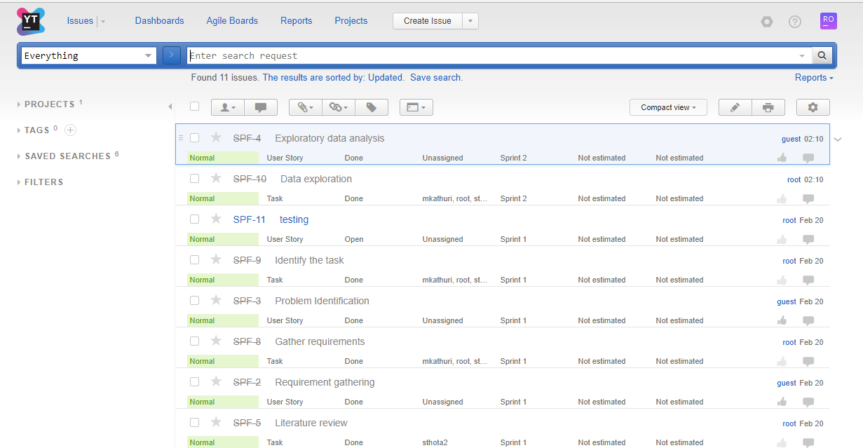
You track status

Slide 23
Questions & Answers
Shravan:
How clean is the data? Does lot of preprocessing is needed?
Ans: There are few missing values in the data in few columns, and there are also few outliers which need to be removed.
2. What models can be applied to the data?
Ans: Classification models such as Random forest methods or Trees models are to be build to classify the Spy plane.
3. What assumptions are we going to make to build our model?
Ans. The data is independent and identically distributed
Models are trained on a set and tested on the other with an assumption that the data is highly correlated.

Slide 24
Questions & Answers
Meghna:
How are the models validated?
Ans. Models that are applied will be checked for performance and validated against test data
2. Is the data consistent or are we going to perform data cleaning operations?
Ans. May be we will need to perform few operations to sort data accordingly.
3. Is the flight data only in the United states or has it even covered Mexico and others?
It’s got data from the United States, Alaska, Hawaii, and Puerto Rico.
Shreyasi:
How is data collected? What are the potential sources?
Ans. Most part of the data is collected from Kaggle, which has data from various other sources that include Flight24 radar, Federal Aviation Administration.
2. What methods are suitable for our data to visualize it the best? How are we going work on Geo-mapping?
Ans. Geo-mapping software needs to be enabled. This technology takes the data with a location element and visualizes it.

Slide 25

Have some back up slides just in case!

